Slide 1



Amazon Simple Storage Service (S3): Cloud Storage Simplified
Amazon Simple Storage Service (Amazon S3) is a versatile cloud storage solution provided by Amazon Web Services (AWS). It offers scalable, secure, and reliable object storage, making it an ideal choice for businesses and individuals alike. This guide will introduce you to the key concepts, features, and applications of AWS S3, helping you understand how this powerful service can meet your storage needs.
by Ram N Java

Slide 2

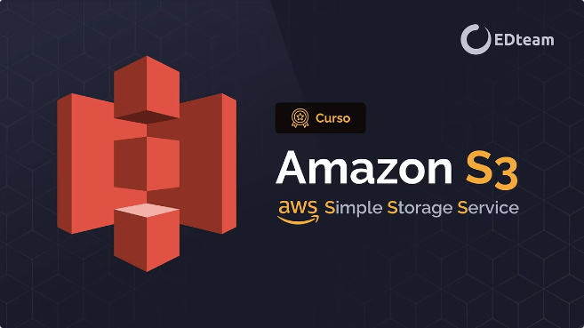
What is AWS S3?
Online Storage Service
Amazon S3 is an online storage service where you can store and retrieve any amount of data at any time.
Highly Durable
It's designed to be highly durable, ensuring your data
remains safe and accessible.
Scalable
S3 can easily scale to accommodate your growing storage
needs.
Secure
With robust security features, S3 keeps your data protected
from unauthorized access.

Slide 3


Key Concept: Buckets
1
Container for Objects
Buckets are containers for storing objects (files) in Amazon S3.
2
Unique Names
Each bucket has a unique name, making it easy to identify and manage.
3
Grouping Objects
Buckets are used to group related objects together, providing organization to your storage.

Slide 4
Key Concept: Objects
File Storage
Data and Metadata
Unique Identifier
Objects are the files you store in S3. They can be of any type and size, from a few bytes to terabytes.
Each object consists of data (the file content) and metadata (information about the data).
Objects are identified by a unique key, which serves as the file name within the bucket.

Slide 5


Key Concept: Keys
1
Unique Identifier
A key is a unique identifier for an object within a bucket.
2
File Name
The key is essentially the file name and can include path-like structures to organize objects.
3
Organization
Keys help in organizing and retrieving objects efficiently within your S3 storage.

Slide 6

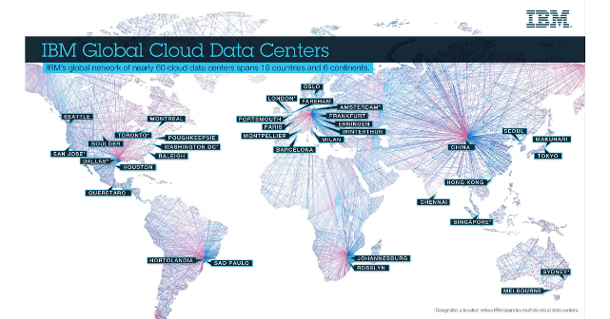
Key Concept: Regions
Geographic Areas
AWS S3 stores data in regions, which are geographic areas where your data is physically stored.
Performance Optimization
Choosing a region close to your users can reduce latency and improve performance.
Data Sovereignty
Regions allow you to comply with data sovereignty requirements by storing data in specific geographic locations.

Slide 7

How Does S3 Work?
1
Creating a Bucket
You start by creating a bucket in a specific region. This bucket will hold your objects.
2
Uploading Objects
You can upload objects (files) to the bucket. Each object is stored with a key.
3
Accessing Objects
Objects can be accessed via unique URLs. Permissions can be set to control who can access or modify the objects.
4
Managing Data
You can organize data using prefixes and delimiters, similar to folders and subfolders. S3 provides versioning to keep multiple versions of an object, useful for backups and data recovery.

Slide 8
Key Features: Scalability and Durability
Scalability
Durability
S3 automatically scales to handle any amount of data, making it ideal for small applications as well as large enterprises.
S3 is designed for 99.999999999% (11 9's) durability, meaning your data is extremely safe and unlikely to be lost.

Slide 9
Key Features: Availability and Security
Availability
Security
S3 offers 99.99% availability, ensuring your data is accessible when you need it.
S3 provides multiple security features, including encryption (both at-rest and in-transit), access control policies, and integration with AWS Identity and Access Management (IAM).

Slide 10
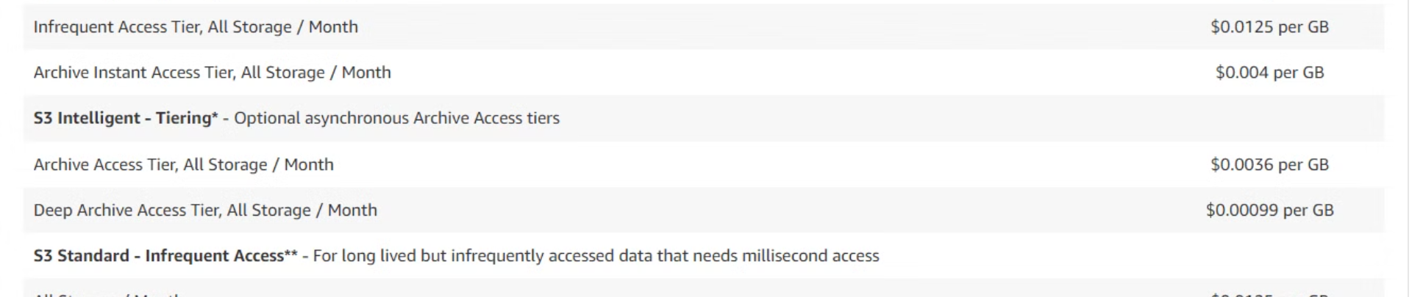
Cost-Effective Storage Solution
1
Pay-as-you-go Model
2
Flexible Pricing
3
No Upfront Costs
S3 uses a pay-as-you-go pricing model, so you only pay for the storage you use.
Different storage classes are available to optimize costs based on access patterns.
There are no upfront investments or long-term commitments required to start using S3.

Slide 11

Common Use Case: Backup and Restore
Data Protection
Easy Restoration
Versioning
S3 is often used for storing backups of important data, ensuring it's safe from loss or corruption.
When needed, data can be quickly and easily restored from S3 backups.
S3's versioning feature allows you to keep multiple versions of files, making it easy to revert to previous states.

Slide 12
Common Use Cases:
Data Archiving and Content Storage
Data Archiving
Content Storage and Delivery
S3 offers long-term storage of infrequently accessed data at a lower cost, perfect for archiving purposes.
S3 is ideal for storing and serving
static content like images, videos, and documents for websites and applications.

Slide 13
Common Use Cases:
Big Data Analytics and Disaster Recovery
Big Data Analytics
Disaster Recovery
S3 is used for storing large datasets that can be processed by big data analytics services like Amazon EMR or AWS Glue.
S3 provides a reliable solution for
disaster recovery, ensuring data is safe and recoverable in case of unforeseen events.

Slide 14


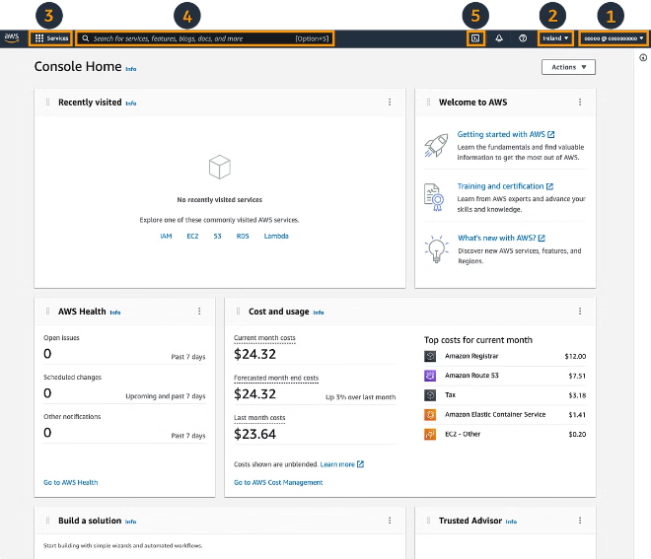



Getting Started with AWS S3
Sign Up for AWS
Create an AWS account if you don't already have one.
Access S3
Log in to the AWS Management Console and navigate
to the S3 service.
Create a Bucket
Follow the steps to create a bucket and start
uploading objects.
Explore Features
Experiment with S3 features like versioning,
access controls, and data management.

Slide 15


Conclusion:
The Power of Amazon S3
1
Versatile Storage Solution
Amazon S3 is a powerful and versatile cloud storage service that's easy to use for beginners and capable of meeting the needs of advanced users.
2
Scalability and Durability
Its scalability and durability make it suitable for businesses of all sizes and storage needs.
3
Security and Reliability
With robust security features and high availability, S3 ensures your data is safe and accessible when you need it.
4
Wide Range of Applications
From backups to big data analytics, S3's versatility makes it an excellent choice for a wide variety of storage needs.

